Slide 1
Person Detection
CSE541 - Computer Vision Project
Group-9 members:
No. | Name | IDs
1 | Zalak Shah | AU2040217
2 | Dhruvam Bhalodiya | AU2040041
3 | Freyal Shah | AU2040228
4 | Khush Soni | AU2040239

Slide 2
Introduction and Problem statement
Introduction:
One of the most promising applications of computer vision is person detection, which involves identifying and locating individuals in images or videos. Person detection has significant applications in surveillance, security, and object tracking, among others. Accurate and efficient person detection can provide valuable insights into human behavior and help prevent criminal activities.
Problem Statement:
To create a computer vision model that can distinguish people from other objects in an image or video and accurately detect their location within the frame by drawing a bounding box around them.

Slide 3
Our Approach
We are using YOLOv8 for the detection that involves data collection, annotation, preparation, model training, evaluation, optimization, and deployment. First, diverse images and videos are collected and annotated with bounding boxes. Then, the data is split into training, validation, and testing sets, preprocessed, and used to train the model. This approach enables accurate and efficient person detection in various real-world scenarios.
Why YOLOv8?
YOLOv8 model is very fast and can detect objects in real-time.
It can achieve state-of-the-art performance on variety of datasets.
It can detect objects in different environments and scenarios.

Slide 4
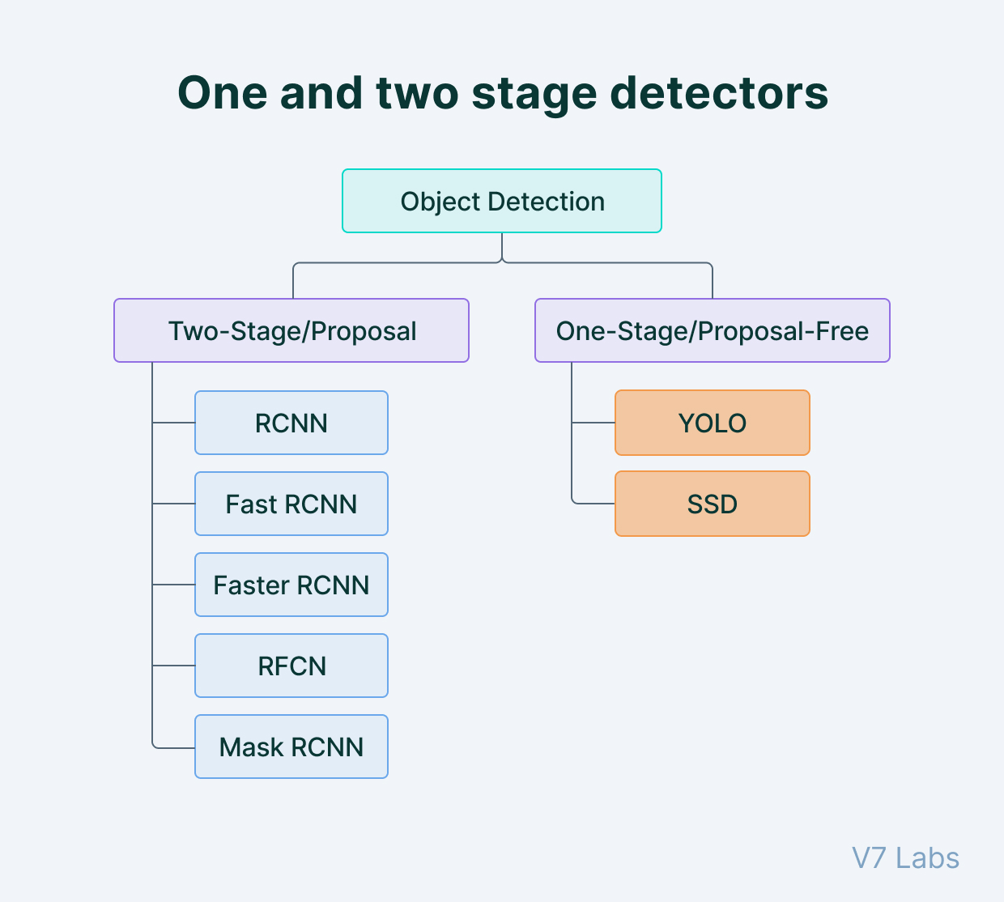
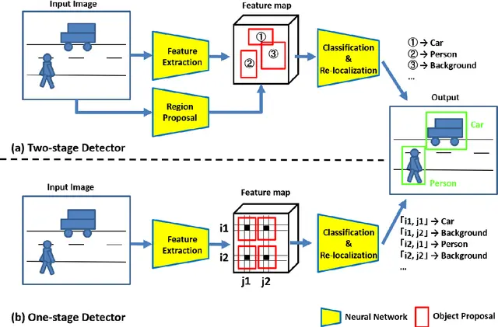
Existing Body of work
Image 1: Rizzoli, A. (2023, February 3). The Ultimate Guide to Object Detection. V7. https://www.v7labs.com/blog/object-detection-guide
Image 2: Phan, T.H., & Yamamoto, K. (2020). Resolving Class Imbalance in Object Detection with Weighted Cross Entropy Losses. ArXiv, abs/2006.01413.

Slide 5
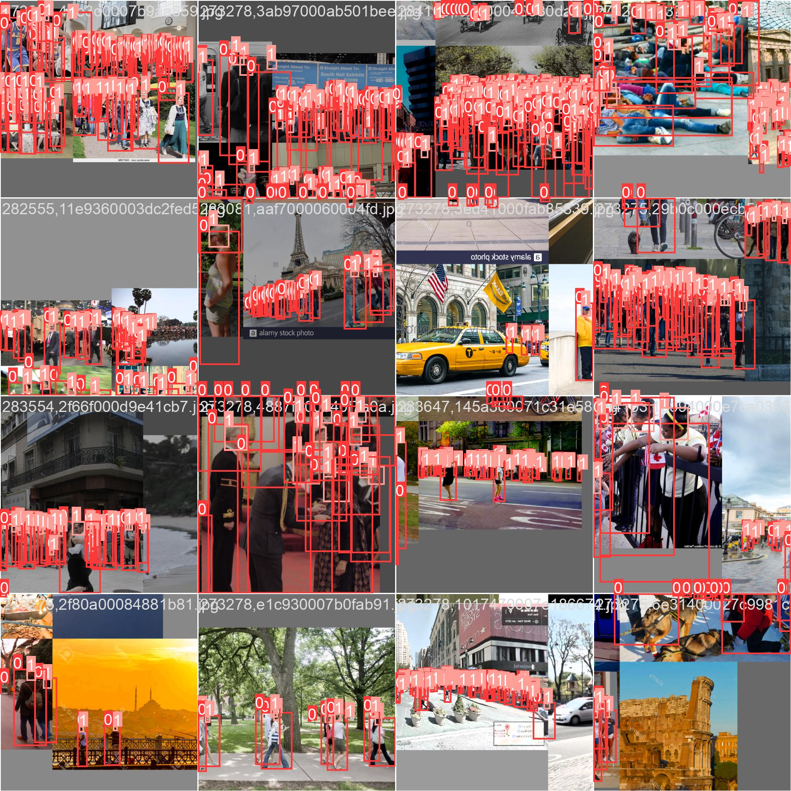
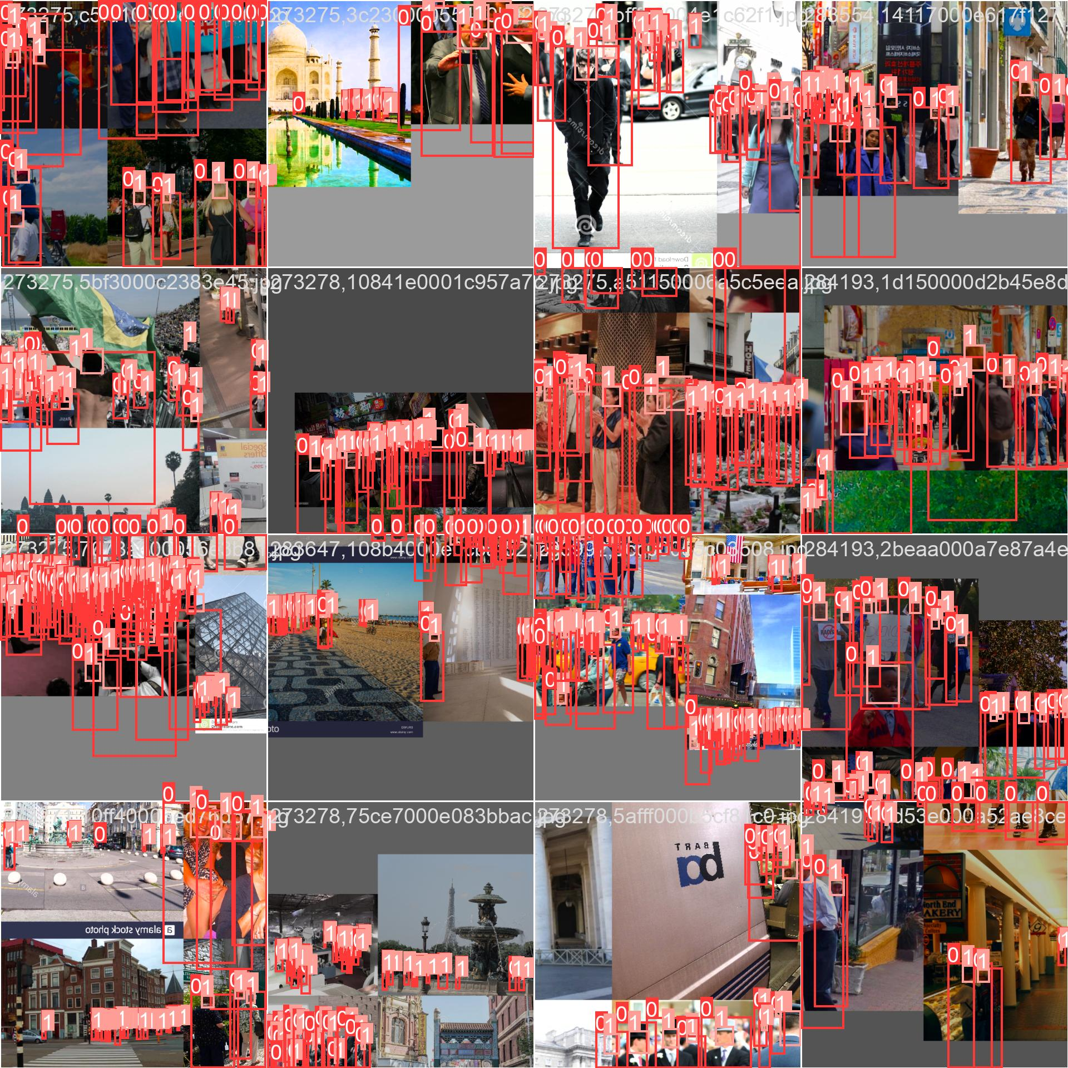
Dataset
The dataset contains a combination of pascal VOC and crowd dataset. Of the 9523 images, 80 percent of the images were used for training 20 percent for testing.
Crowd Human Dataset provides diverse images with occlusion, brightness, and different viewpoints. The images are annotated by multiple annotators so it can capture variability in terms of annotation style.
The pascal VOC dataset provides standardized annotations. This ensures that the model is tested against the same set of annotations. Apart from these, the bounding boxes are more precise in this dataset.
Images: The PASCAL Visual Object Classes Challenge (VOC2012).
http://pascallin.ecs.soton.ac.uk/challenges/VOC/voc2012/index.html.

Slide 6
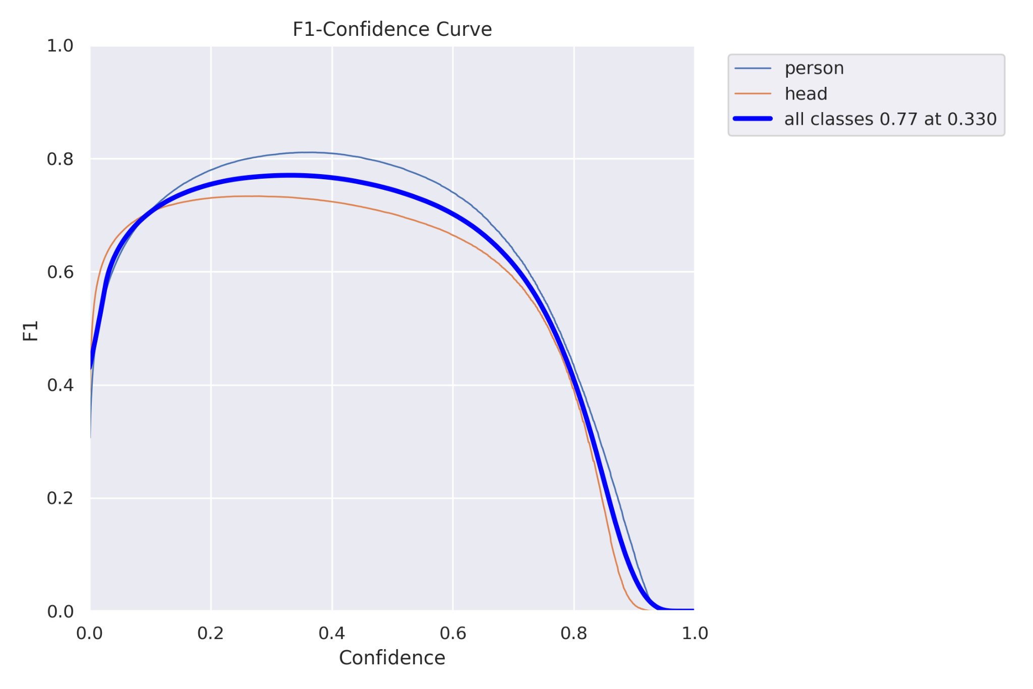
Initial Results
The F1 confidence curve plots the F1 score as a function of the confidence threshold used by the model. The confidence threshold is the minimum level of confidence required for the model to classify a given instance as positive.
As the confidence threshold increases, the precision of the model will increase while the recall will decrease.
By examining the F1 confidence curve, the optimal confidence threshold can be specified, here the confidence value that optimizes the precision and recall is 0.33 with the f1 score of 0.77.

Slide 7
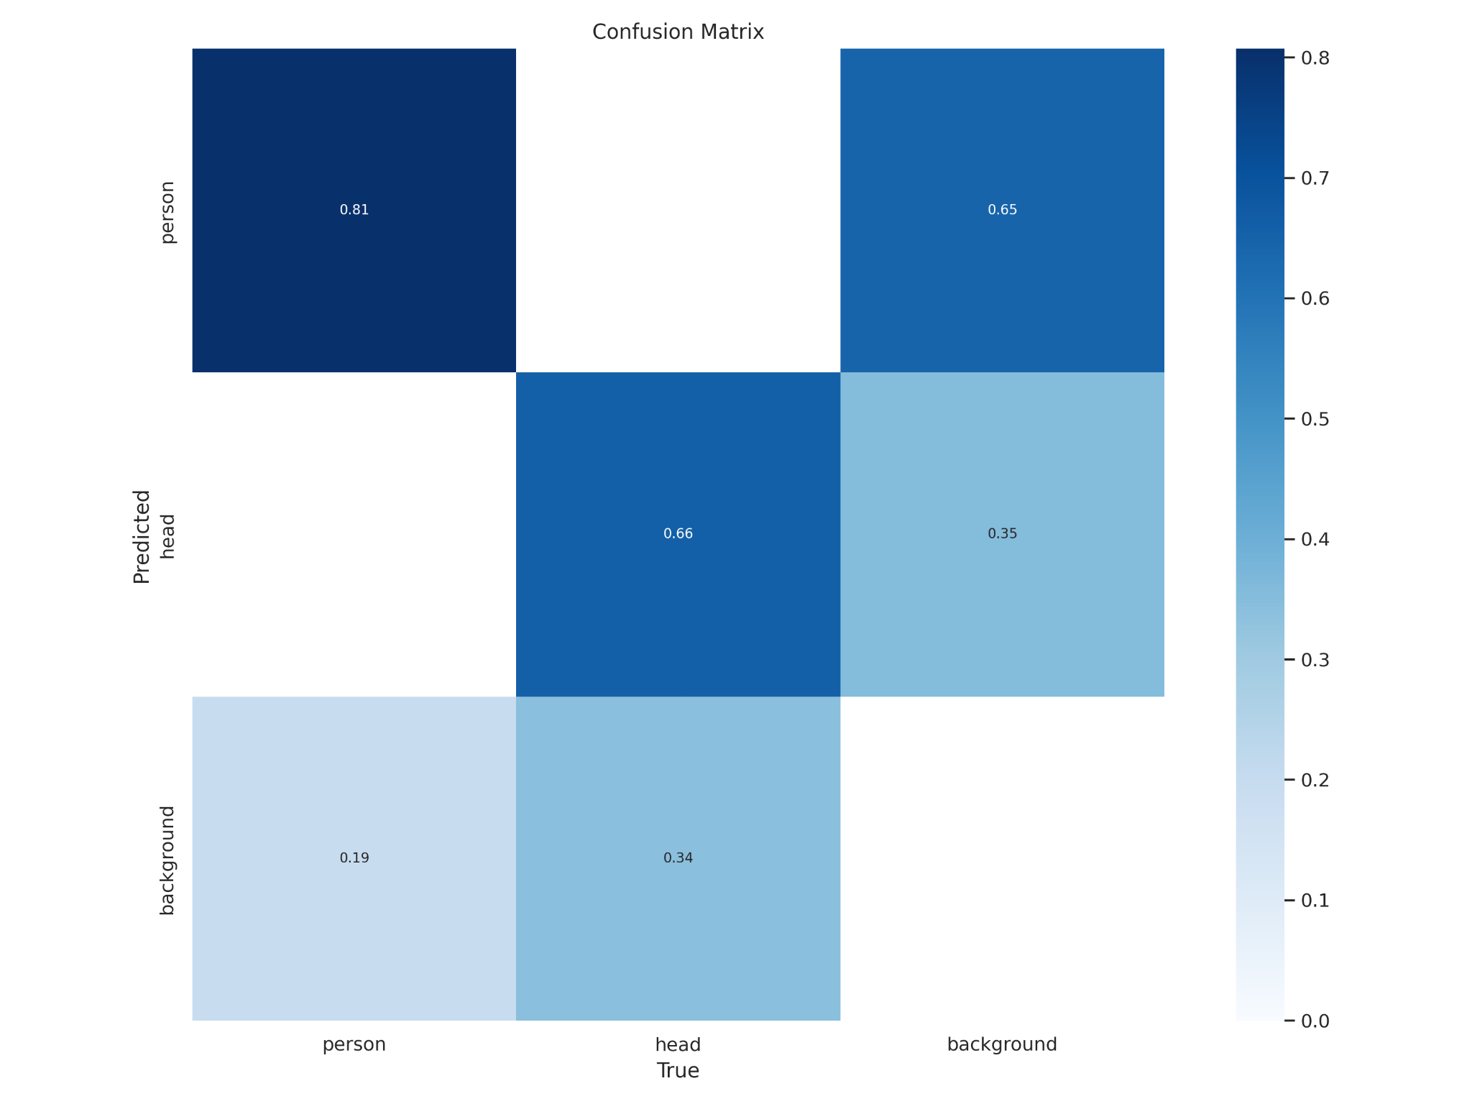
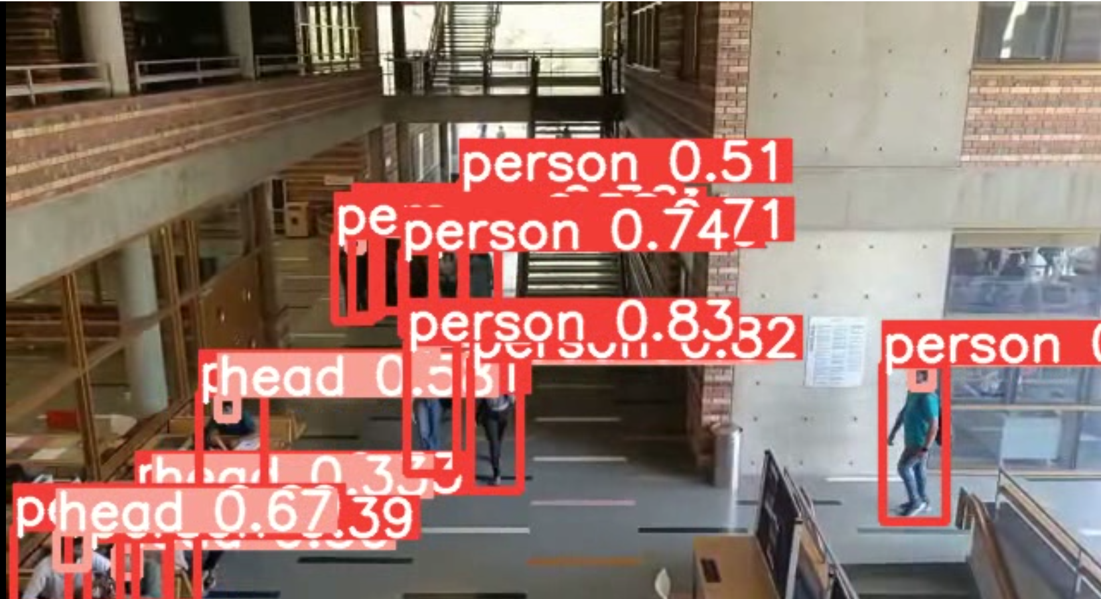
Initial Results(Continued)
A confusion matrix is a table used to evaluate the performance of a classification model. It compares the predicted labels of a model with the true labels to measure its accuracy.
The true positive value of the person parameter is 0.81, which means that the model correctly identified 81% of the actual person instances.

Slide 8
Role of each group member in the project
Freyal Shah - Finding the performance of the model in terms of f1-score and recall and researching about different losses incurred while training.
Zalak Shah - Researching about the existing body of work and Implementation of code with preparation of presentation.
Khush Soni - Analysing the dataset, analyzing the results and assisted with implementation of code.
Dhruvam Bhalodiya - Helped in making presentations and reports. Helped with analyzing of information.

Slide 9
References
[1] P. Viola and M. Jones, “Rapid object detection using a boosted cascade of simple features,” in CVPR, vol. 1. IEEE, 2001, pp. I–I.
[2] P. Viola and M. J. Jones, “Robust real-time face detection,” International journal of computer vision, vol. 57, no. 2, pp. 137–154, 2004.
[3] J. R. Uijlings, K. E. Van De Sande, T. Gevers, and A. W. Smeulders, “Selective search for object recognition,” International journal of computer vision, vol. 104, no. 2, pp. 154–171, 2013.
[4] J. Redmon, S. Divvala, R. Girshick, and A. Farhadi, “You only look once: Unified, real-time object detection,” in CVPR, 2016, pp. 779–788.
[5] L. V. G. K. I. W. ,. W. Z. Mark Everingham, "The PASCAL Visual Object Classes (VOC) Challenge," International Journal of Computer Vision, 2010.

